Slide 1
NBODY SIMULATION
AMSC 2022

Slide 2
Some questions...
Why is this simulation useful?
What are the main challenges in this approach to physical problems?
Why parallel computing offers a powerful framework to approach scientific computing procedures of this nature

Slide 3
Why is this simulation useful / interesting?
Studying the interaction between particles allows us to explore on a macroscopic scale the effect of the interaction of elements in complex systems, exploiting the fact that the physical rules that governate the phenomena we are studying are extremely simple, but can lead to a great overall complexity in the behavior of our system.
Another great example of this kind of mechanism, is the populare «Game of Life» algorithm , which is inherently extremely similar to a particle simulation, even if on a more biological point of view.
During our analysis we tried to reach a similar result, but focusing on the mechanical behavior of a complex system

Slide 4
What are the main challenges in this approach to physical problems?
Studying particles is not easy. We have to model interactions among them , finding the optimal trade off between computational complexity and physical sense of the found solution.
From a parallel computing point of view, we can identify the whole problem with a «sort of» stencil pattern. In fact, we are not in a map situation – since the state of a particle at the next interation is not indipendent from the previous state of other particles – and moreover the amount of information received by every particle has to be weigthed by the distances, which can be interpreted, in some sense, as the strength factors of the edges on a graph.

Slide 5
Why parallel computing offers a powerful framework to approach scientific computing procedures of this nature
As we said, Parallel computing offers a naturally fertile soil for the deployment of a numerical method of this category. If properly implemented, a parallel algorithm is able to exploit the hardware in order to maximize the performance, balancing the flow of information between agents in order to obtain accurate results.
In our case we decided to analyze two different parallel computing solution , in order to be able not only to produce a scalable application but also to measure the improvement induced by the different desing choices.

Slide 6
The technologies
MPI
OpenMP
Some details on the visualization methods and their role in our analysis

Slide 7
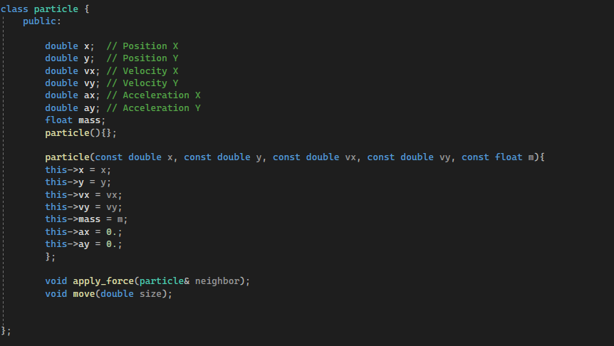
MPI – Code structure and Analysis particle structure

Slide 8
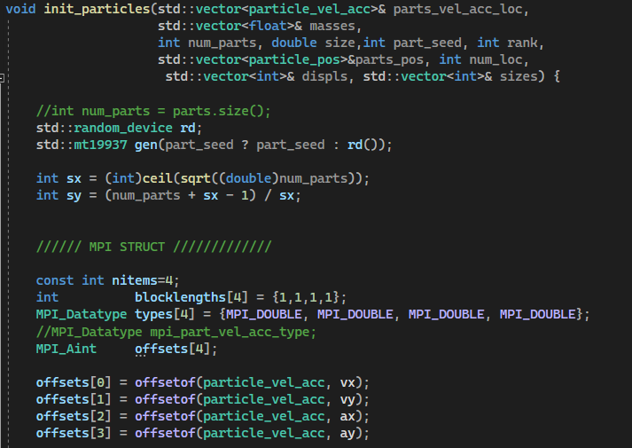
MPI – Code structure and Analysis Particle initialization (1)

Slide 9
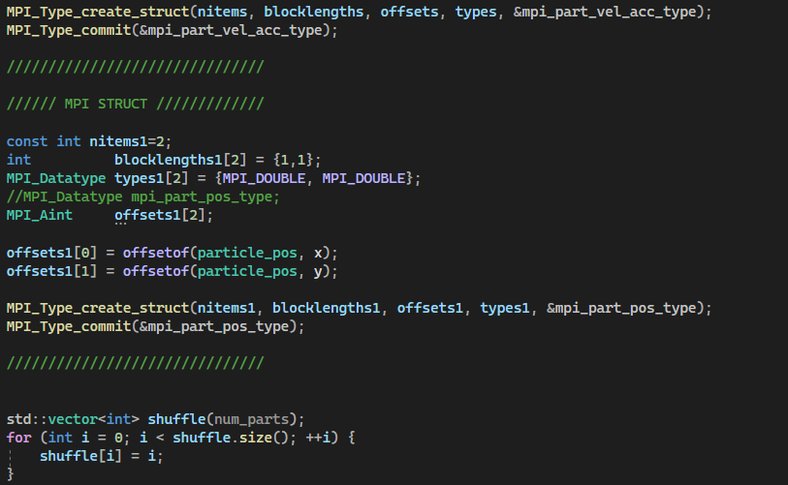
MPI – Code structure and Analysis Particle initialization (2)

Slide 10
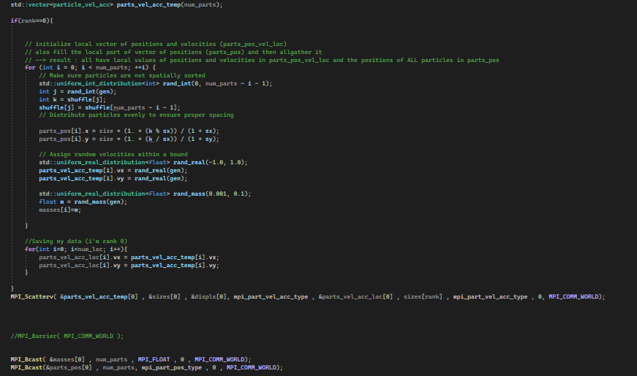
MPI – Code structure and Analysis Particle initialization (3)

Slide 11
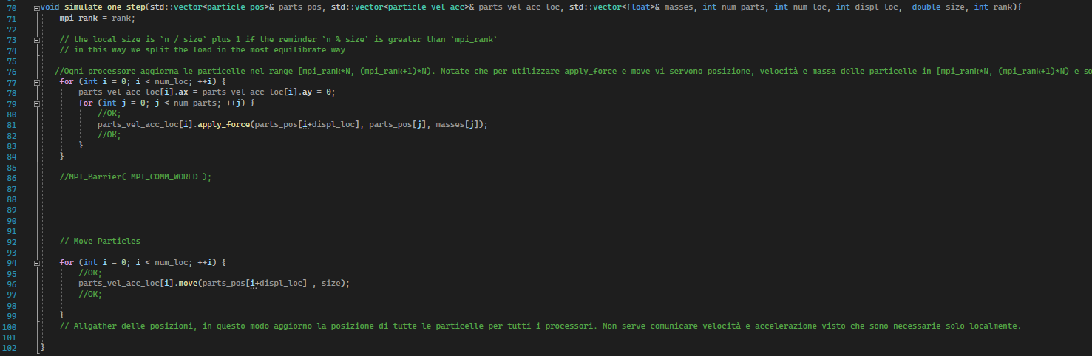
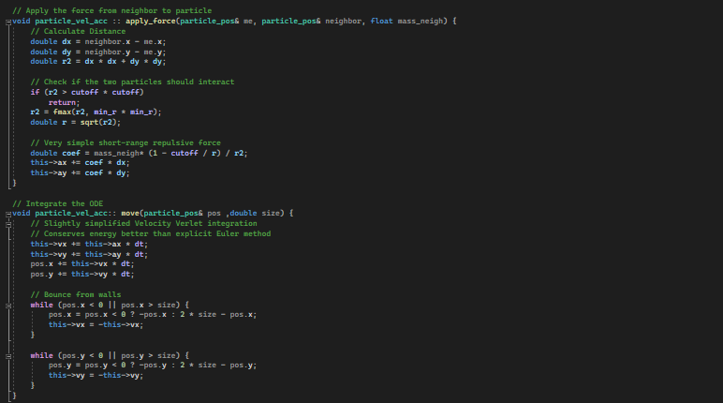
MPI – Code structure and Analysis Simulation of one step

Slide 12
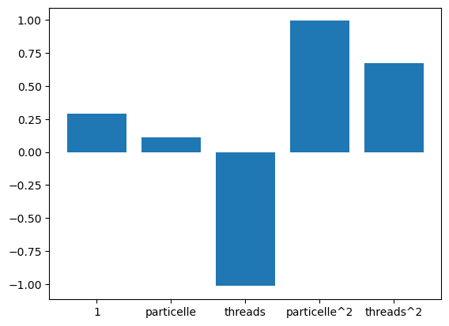
MPI – Result Analysis
In order to explain the behavior of the program, we tried to approach the analysis with a stochastic point of view. We ran several configurations of the mpi version and we produced a csv table ; starting from it we produced a linear model in order to explain the execution time in function of number of threads and number of particles.

Slide 13
MPI – Result Analysis
Using standardized variables in the linear model we are able to extract information regarding the behavior of the program ; While the overhead plays an important role, we notice that
The time tends to be heavily quadratic wrt to number of particles
The time is both linearly (negatively) and quadratic (positively) dependent on number of theads , which may suggest that after an initial improvement the speed – up tends to stabilize (or decrease)

Slide 14
OPENMP

Slide 15
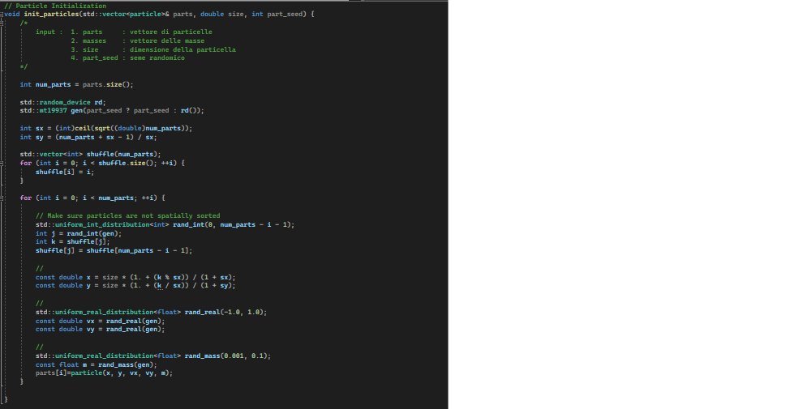
OpenMP – Code structure and Analysis Particle Initialization

Slide 16
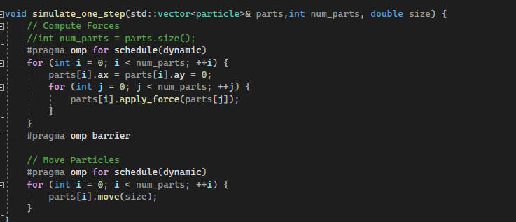
OpenMP – Code structure and Analysis One Step Simulation

Slide 17
Performance

Slide 18
Performance

Slide 19

Visualization (using pillow library)

